Slide 1



UNIT 1
Look back 1
Part 1

Slide 2
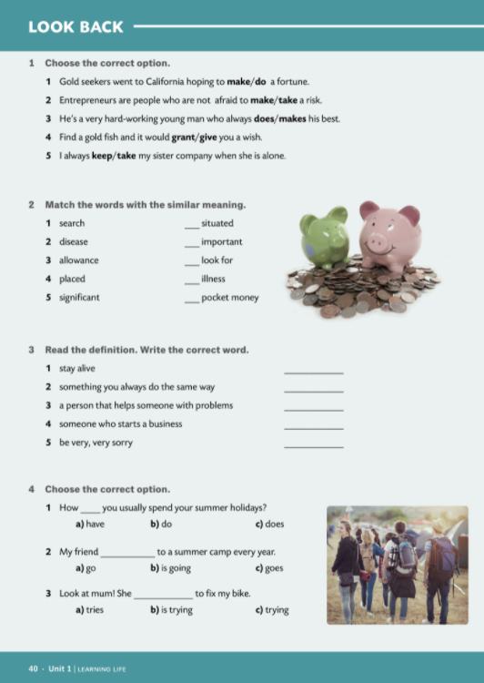
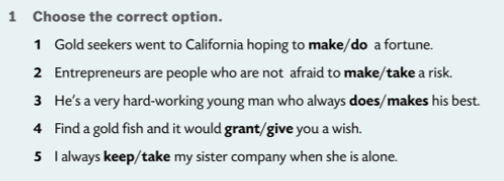

4
5
1
2
3

Slide 3
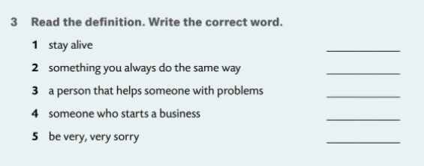
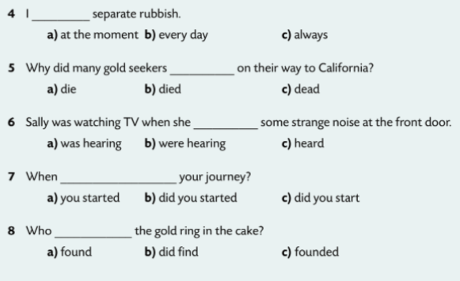
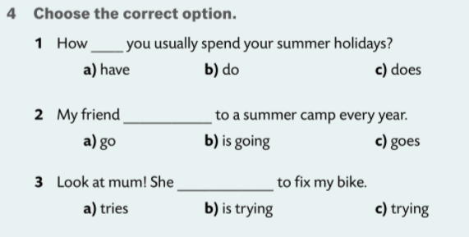
survive
routine
counsellor
entrepreneur
regret

Slide 4
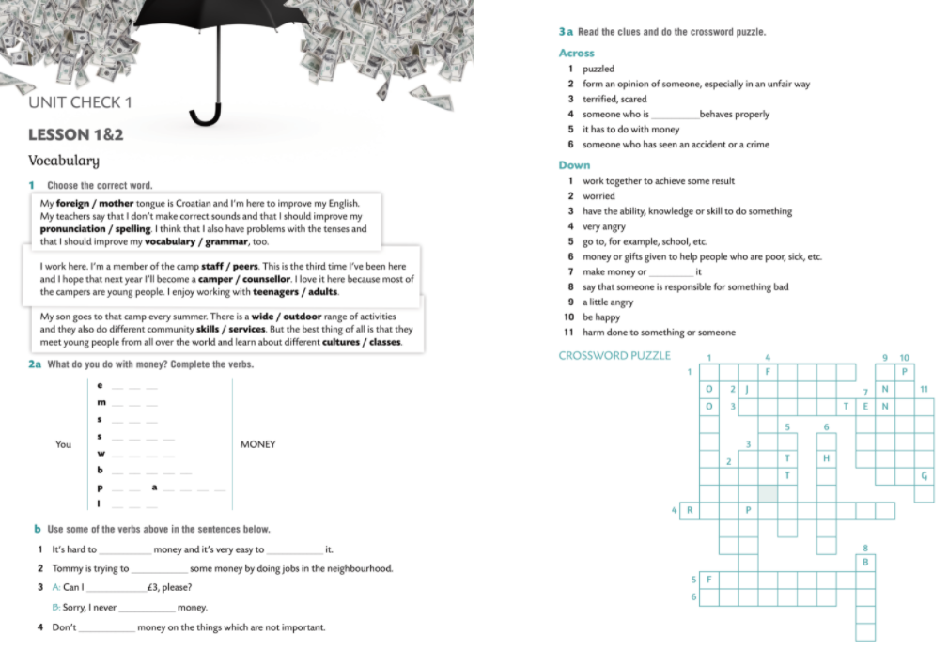
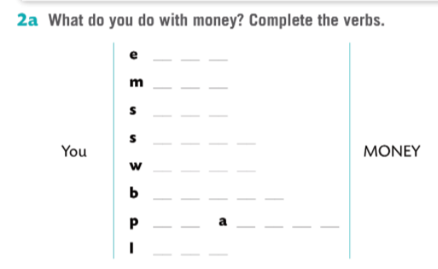
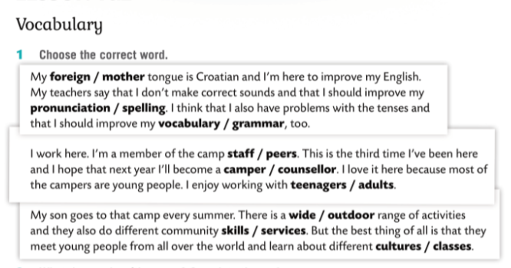

arn
ake
ave
end
aste
orrow
ut
side
end
make/earn
spend
put aside
borrow
lend
waste

Slide 5

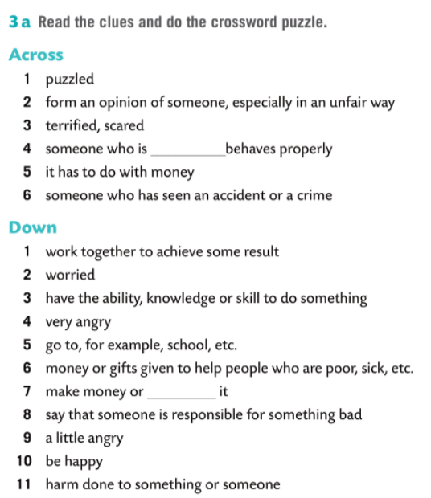
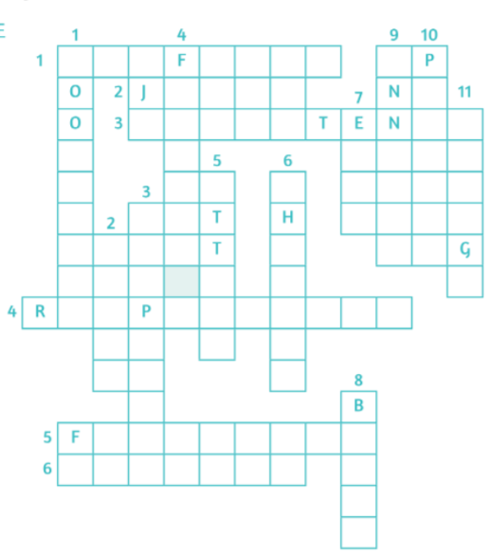
confused
judge
frightened
responsible
financial
witness
cooperate
upset
competent
furious
attend
charity
earn
blame
annoyed
pleased
damage

Slide 6

